Slide 1

Neural End-to-End Architectures for Speech Recognition in Adverse Environments
Shinji Watanabe
Center for Language and Speech Processing
Johns Hopkins University
Joint work with John Hershey, Takaaki Hori, Shigeru Katagiri, Suyoun Kim, Tsubasa Ochiai, Tomoki Hayashi, Hiroshi Seki, Jonathan Le Roux

Slide 2
Center for Language and Speech Processing (CLSP)
Frederick Jelinek (1932 –2010)
Statistical speech recognition and machine translation
"Every time I fire a linguist, the performance of the speech recognizer goes up”
1972 - 1993: IBM
1993 - 2010: JHU and established CLSP, and Johns Hopkins Summer Workshop (now Jelinek workshop)

Slide 3
Jelinek methodology (1970s-)

Slide 4
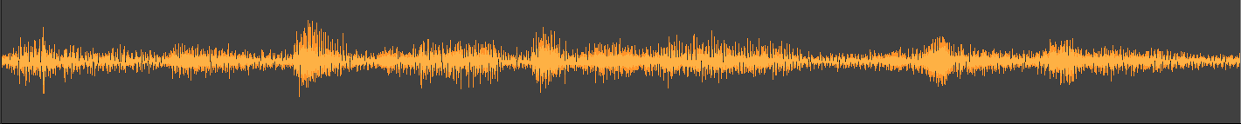



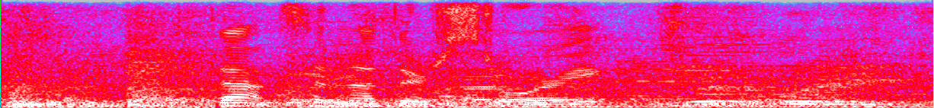

Jelinek methodology (1970s-)
Automatic Speech Recognition: Mapping physical signal sequence to linguistic symbol sequence
“That’s another story”

Slide 5

Jelinek methodology (1970s-)
$$\arg{\max_{W}{p(W|X)}}=\arg{\max_{W}{p\left(X | W\right)p(W)}}$$

Slide 6
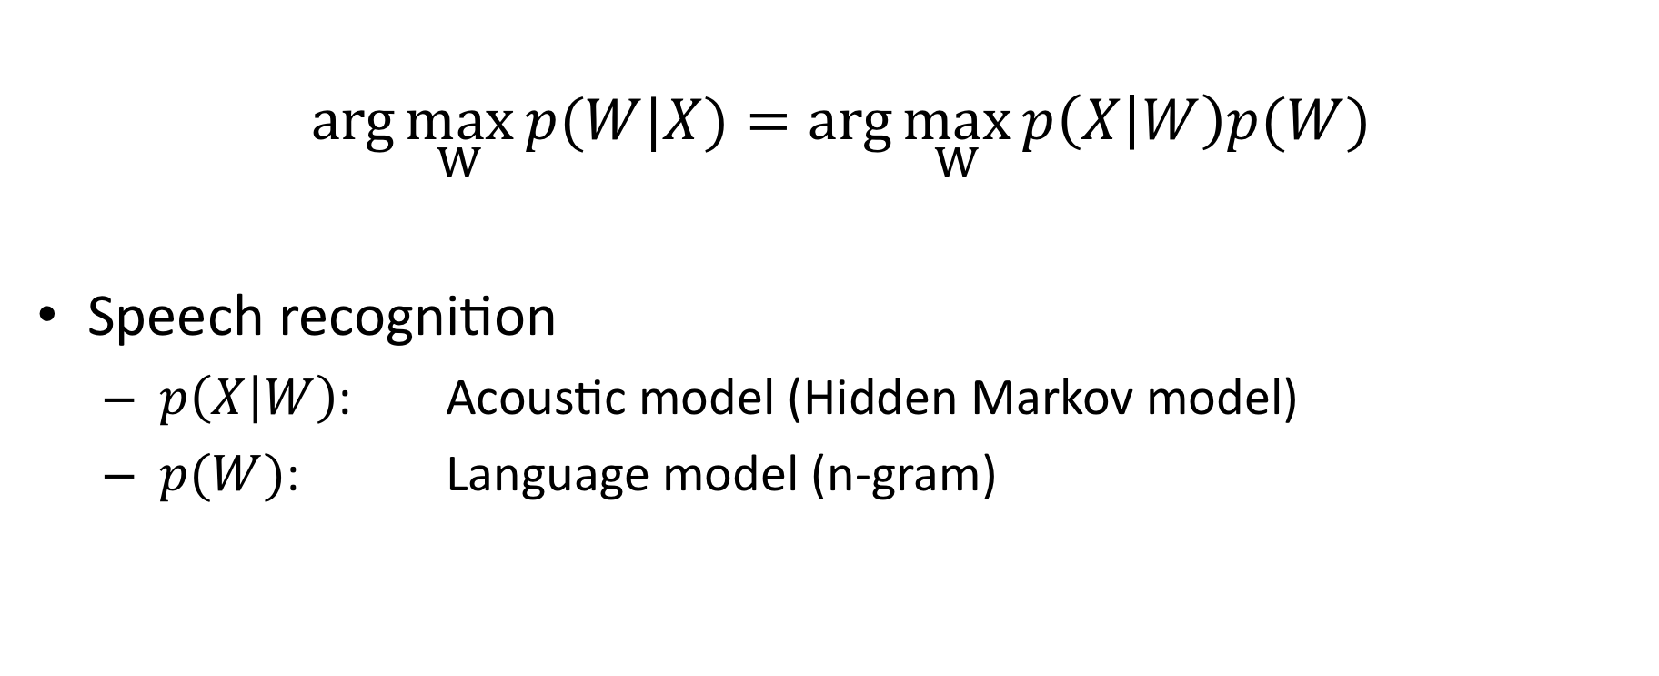
Jelinek methodology (1970s-)
$$\arg{\max_{W}{p(W|X)}}=\arg{\max_{W}{p\left(X | W\right)p(W)}}$$
Speech recognition
  $p\left(X | W\right)$: Acoustic model (Hidden Markov model)
  $p(W)$: Language model (n-gram)

Slide 7
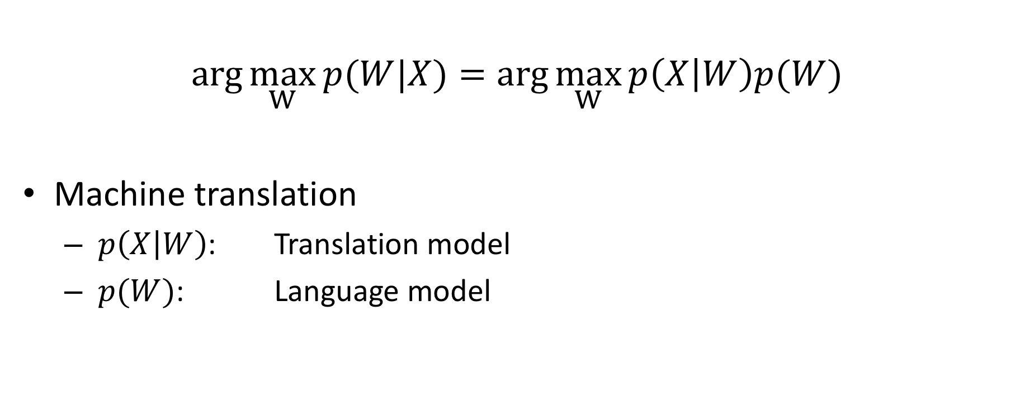
Jelinek methodology (1970s-)
$$\arg{\max_{W}{p(W|X)}}=\arg{\max_{W}{p\left(X | W\right)p(W)}}$$
Machine translation
  $p\left(X | W\right)$: Translation model
  $p(W)$: Language model

Slide 8
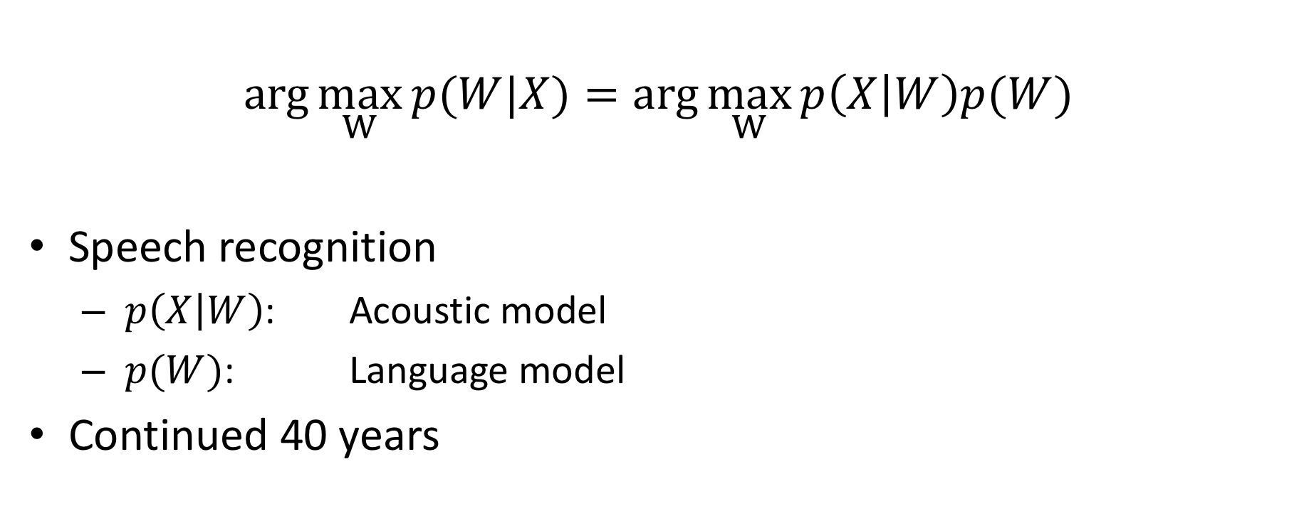
Jelinek methodology (1970s-)
$$\arg{\max_{W}{p(W|X)}}=\arg{\max_{W}{p\left(X | W\right)p(W)}}$$
Speech recognition
  $p\left(X | W\right)$: Acoustic model
  $p(W)$: Language model
Continued 40 years

Slide 9
Jelinek methodology (1970s-)
$$\arg{\max_{W}{p(W|X)}}=\arg{\max_{W}{p\left(X | W\right)p(W)}}$$
Speech recognition
  $p\left(X | W\right)$: Acoustic model
  $p(W)$: Language model
Continued 40 years
Big barrier:
noisy channel model
HMM
n-gram
etc.

Slide 10
However,

Slide 15

Sequence to Sequence
Directly model $p(W|X)$ with a single neural network
Great success in neural machine translation
sos
c₁
c₂
…
eos
s₁
s₂
…
s_{J}
h₁
h₂
h₃
h₄
h₅
h₆
h₇
h₈
…
h_{T}
x₁
x₂
x₃
x₄
x₅
x₆
x₇
x₈
…
x_{T}

Slide 16
Outline
End-to-end speech recognition
  Hybrid CTC/attention-based end-to-end speech recognition
  Multi-task CTC/attention learning (ICASSP’17)
  Joint CTC/attention decoding (ACL’17)
Extensions in adverse environments
  Multichannel end-to-end speech recognition (ICML’17, MLSP’17)
  Multi-lingual end-to-end speech recognition (ASRU’17, ICASSP’18)
  Multi-speaker end-to-end speech recognition (ICASSP’18, ACL’18)
Open source project
  ESPnet: End-to-end speech processing toolkit (Interspeech’18)

Slide 17


Challenges
Can you recognize the following speech?
  Noisy speech recognition
  Multilingual code-switching situation
  Multispeaker situation
  Multispeaker multilingual code-switching

Slide 18
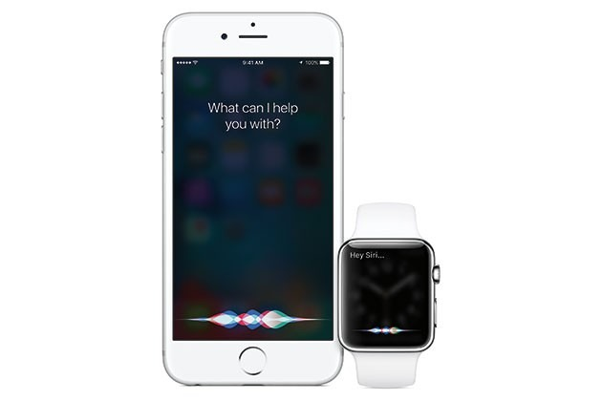
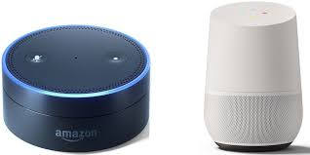
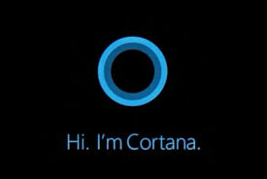
Automatic Speech Recognition (ASR)
Widely used in many
applications …
Consist of an acoustic model, a pronunciation lexicon, a language model, and WFST-based decoding
Require a lot of linguistic resources
Difficult to build ASR systems for non-experts
speech
words
Decoding
Rescoring
WFST
Acoustic
model
Lexicon
Language
model
ASR system

Slide 19
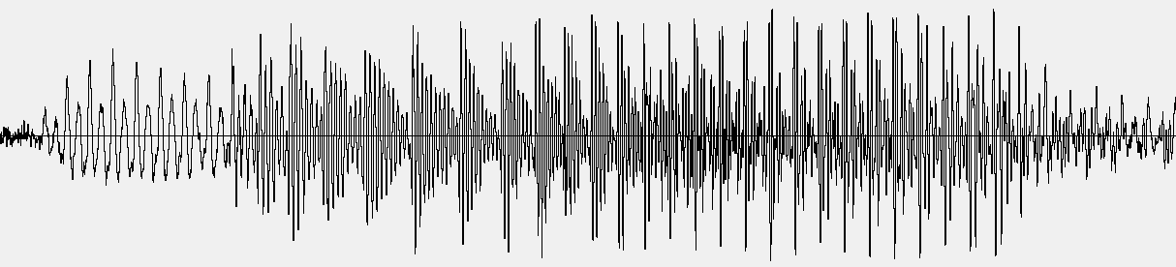
Automatic Speech Recognition (ASR)
Pronunciation lexion
A AH
A'S EY Z
A(2) EY
A. EY
A.'S EY Z
A.S EY Z
AAA T R IH P AH L EY
AABERG AA B ER G
AACHEN AA K AH N
AACHENER AA K AH N ER
AAKER AA K ER
AALSETH AA L S EH TH
AAMODT AA M AH T
AANCOR AA N K AO R
AARDEMA AA R D EH M AH
AARDVARK AA R D V AA R K
AARON EH R AH N
AARON'S EH R AH N Z
AARONS EH R AH N Z
…
Speech data with phonetic transcription
SIL HH AH L OW SIL DH IH S IH Z JH AA N SIL
(Hello, this is John.)
Widely used in many
applications …
Consist of an acoustic model, a pronunciation lexicon, a language model, and WFST-based decoding
Require a lot of linguistic resources
Difficult to build ASR systems for non-experts
speech
words
Decoding
Rescoring
１００K~1M words!
Text corpus
WFST
こんにちは今日はいい天気ですね。
でも天気予報によると、午後から雨に
なるらしいですよ。
↓
こんにちは_今日_は_いい_天気_です_ね_。
でも_天気_予報_に_よる_と_、_午後_から_雨_に
_なる_らしい_です_よ_。
Acoustic
model
Lexicon
Language
model
Need tokenization!
ASR system

Slide 20
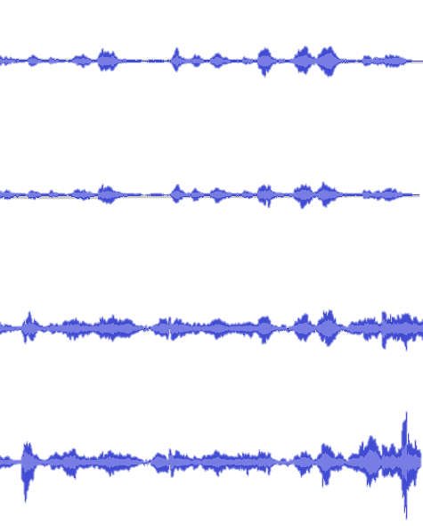



Speech recognition pipeline
G OW T UW
G OW Z T UW
“I want to go to
Johns Hopkins campus”
Feature extraction
Acoustic modeling
Lexicon
Language modeling
“go to”
“go two”
“go too”
“goes to”
“goes two”
“goes too”
$$p(X|L)$$
$$p(L|W)$$
$$p(W)$$

Slide 21
Speech recognition pipeline
Train a deep network that directly maps speech signal to the target letter/word sequence
Greatly simplify the complicated model-building/decoding process
Easy to build ASR systems for new tasks without expert knowledge
Potential to outperform conventional ASR by optimizing the entire network with a single objective function
“I want to go to
Johns Hopkins campus”
End-to-end ASR

Slide 22
End-to-end ASR (1)
Connectionist temporal classification (CTC)
[Graves+ 2006, Graves+ 2014, Miao+ 2015]
Use bidirectional RNNs to predict frame-based labels including blanks
Find alignments between X and Y using dynamic programming
Relying on conditional independence assumptions
Output sequence is not well modeled
CTC
y₁
y₂
…
y₃
Forward-Backward
or Viterbi algorithm
_
z₂
_
z₄
_
_
z₇
z₈
…
_
Stacked
BLSTM
h’₁
h’₂
h’₃
h’₄
h’₅
h’₆
h’₇
h’₈
h’_{T}
h₁
h₂
h₃
h₄
h₅
h₆
h₇
h₈
…
h_{T}
x₁
x₂
x₃
x₄
x₅
x₆
x₇
x₈
…
x_{T}

Slide 23
End-to-end ASR (2)
Attention-based encoder decoder [Chorowski+ 2014, Chan+ 2015]
Combine acoustic and language models in a single architecture
  Encoder: acoustic model
  Decoder: language model
  Attention: alignment
No conditional independence
assumption unlike CTC
  More precise seq-to-seq model
Attention mechanism allows
too flexible alignments
  Hard to train
  the model
  from scratch
sos
y₁
y₂
…
eos
q₀
q₁
…
q_{L-1}
r₀
r₁
r₂
…
r_{L}
Attention
Decoder
H
Encoder
h’₁
h’₂
h’₃
h’₄
…
h’_{T’}
h₁
h₂
h₃
h₄
h₅
h₆
h₇
h₈
…
h_{T}
x₁
x₂
x₃
x₄
x₅
x₆
x₇
x₈
…
x_{T}

Slide 24
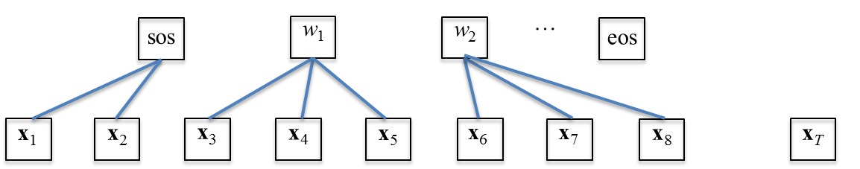
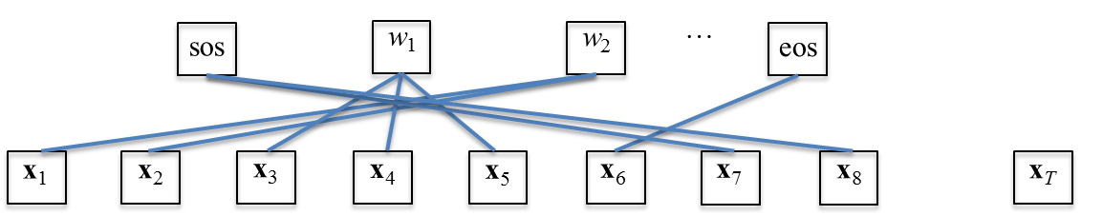
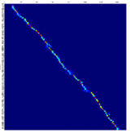
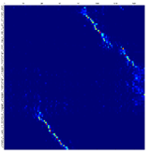
Input/output alignment by temporal attention
Unlike CTC, attention model does not preserve order of inputs
Our desired alignment in ASR task is monotonic
Not regularized alignment makes the model hard to learn from scratch
HMM or CTC case
Attention model case
Input
Input
Output
Output
Example of monotonic alignment
Example of distorted alignment

Slide 25
Outline
End-to-end speech recognition
  Hybrid CTC/attention-based end-to-end speech recognition
  Multi-task CTC/attention learning (ICASSP’17)
  Joint CTC/attention decoding (ACL’17)
Extensions in adverse environments
  Multichannel end-to-end speech recognition (ICML’17, MLSP’17)
  Multi-lingual end-to-end speech recognition (ASRU’17, ICASSP’18)
  Multi-speaker end-to-end speech recognition (ICASSP’18, ACL’18)
Open source project
  ESPnet: End-to-end speech processing toolkit (Interspeech’18)

Slide 26
Hybrid CTC/attention network [Kim+’17]
Multitask learning:
λ: CTC weight
sos
y₁
y₂
…
eos
CTC
…
y₁
y₂
q₀
q₁
…
q_{L-1}
_
z₂
_
z₄
…
_
r₀
r₁
r₂
…
r_{L}
monotonic
alignment
Attention
Decoder
H
Encoder
h’₁
h’₄
…
h’_{T’}
h’₂
h’₃
h₁
h₂
h₃
h₄
h₅
h₆
h₇
h₈
…
h_{T}
x₁
x₂
x₃
x₄
x₅
x₆
x₇
x₈
…
x_{T}
CTC guides attention alignment to be monotonic

Slide 27
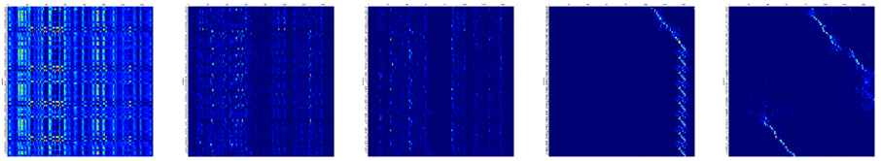
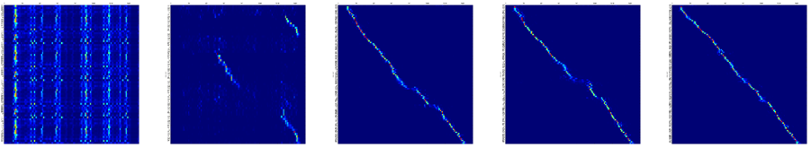
More robust input/output alignment of attention
Alignment of one selected utterance from CHiME4 task
Attention Model
Input
Corrupted!
output
Epoch 1 Epoch 3 Epoch 5 Epoch 7 Epoch 9
Our joint CTC/attention model
Monotonic!
Faster convergence

Slide 28
Joint CTC/attention decoding [Hori+’17]
Use CTC for decoding together with the attention decoder
y₁
y₂
…
sos
y₁
y₂
…
eos
CTC
…
y₁
y₂
q₀
q₁
…
q_{L-1}
_
z₂
_
z₄
…
_
r₀
r₁
r₂
…
r_{L}
Attention
Decoder
H
Shared
Encoder
h’₁
h’₂
h’₃
h’₄
…
h’_{T’}
h₁
h₂
h₃
h₄
h₅
h₆
h₇
h₈
…
h_{T}
x₁
x₂
x₃
x₄
x₅
x₆
x₇
x₈
…
x_{T}

Slide 29
Joint CTC/attention decoding
Decoding objective is changed to the CTC/attention probability
CTC helps select better hypotheses in the decoding phase
V: vocabulary
λ: CTC weight

Slide 30
Language model integration
(shallow fusion)
Connectionist Temporal Classification (CTC)
Recurrent Neural Network Language Model (RNN-LM)
Output word/letters
……
y_{l-1}
y_{l}
……
(1)
Joint
Decoder
CTC
Attention Decoder
RNN-LM
(2)
Shared
Encoder
BLSTM
x₁
……
x_{t}
……
x_{T}
RNN-LM helps better prediction of
output sequence
Input speech

Slide 31
Experiments
Data sets
  HKUST: Mandarin Chinese conversational telephone speech recognition
    Training 167 hours, Development 4.8 hours, Evaluation 4.9 hours
    Input feature: 80 dim. mel-filterbank + pitch feature
    Output labels: 3653
  CSJ: Japanese lecture speech transcription task
    Training 581 hours, Evaluation: task1: 1.9 hours, task2: 2.0 hours, task3: 1.3 hours
    Input feature: 40 dim. mel-filterbank + delta + delta-delta
    Output labels: 3315
Models
  Encoder – 4 layer BLSTM (320 cells)
  Decoder – 1 layer LSTM (320 cells) with location-based attention mechanism

Slide 32
Results
Character Error Rate (%) in HKUST task
Models | Dev. | Eval
Attention model (baseline) | 40.3 | 37.8
CTC-attention learning (MTL) | 38.7 | 36.6
+ Joint decoding | 35.5 | 33.9
Character Error Rate (%) in CSJ task
Models | Task 1 | Task 2 | Task 3
Attention model (baseline) | 11.4 | 7.9 | 9.0
CTC-attention learning (MTL) | 10.5 | 7.6 | 8.3
+ Joint decoding | 10.0 | 7.1 | 7.6

Slide 33
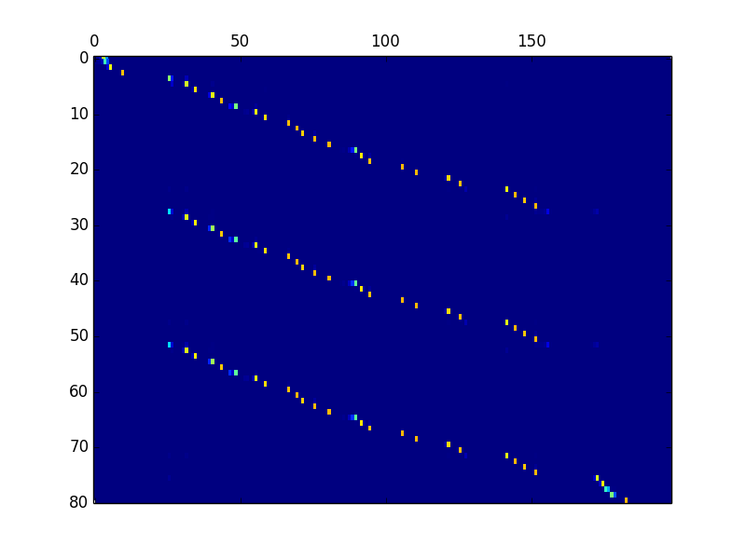
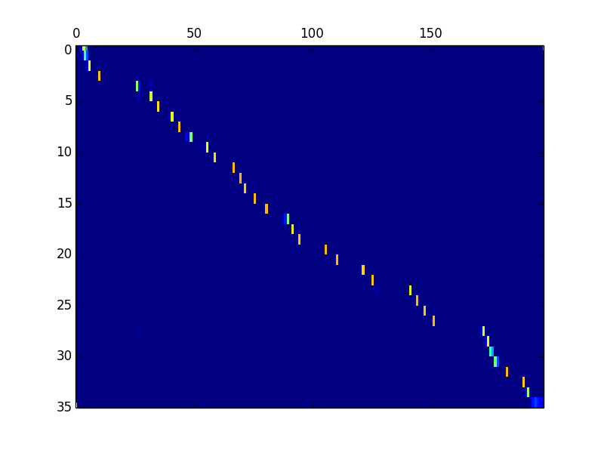
Example of recovering insertion errors (HKUST)
id: (20040717_152947_A010409_B010408-A-057045-057837)
Reference
但 是 如 果 你 想 想 如 果 回 到 了 过 去 你 如 果 带 着 这 个 现 在 的 记 忆 是 不 是 很 痛 苦 啊
Hybrid CTC/attention (w/o joint decoding)
Scores: (#Correctness #Substitution #Deletion #Insertion) 28 2 3 45
但 是 如 果 你 想 想 如 果 回 到 了 过 去 你 如 果 带 着 这 个 现 在 的 节 如 果 你 想 想 如 果 回 到 了 过 去 你 如 果 带 着 这 个 现 在 的 节 如 果 你 想 想 如 果 回 到 了 过 去 你 如 果 带 着 这 个 现 在 的 机 是 不 是 很 ・ ・ ・
w/ Joint decoding
Scores: (#Correctness #Substitution #Deletion #Insertion) 31 1 1 0
HYP: 但 是 如 果 你 想 想 如 果 回 到 了 过 去 你 如 果 带 着 这 个 现 在 的 ・ 机 是 不 是 很 痛 苦 啊

Slide 34
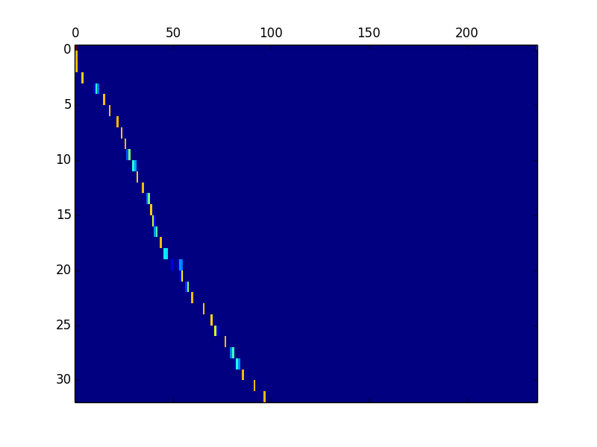
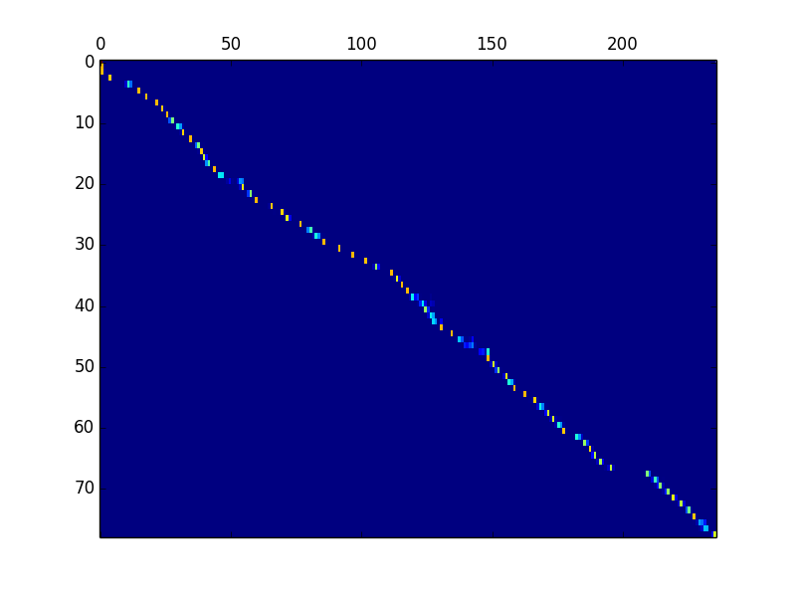
Example of recovering deletion errors (CSJ)
id: (A01F0001_0844951_0854386)
Reference
ま た え 飛 行 時 の エ コ ー ロ ケ ー シ ョ ン 機 能 を よ り 詳 細 に 解 明 す る 為 に 超 小 型 マ イ ク ロ ホ ン お よ び 生 体 ア ン プ を コ ウ モ リ に 搭 載 す る こ と を 考 え て お り ま す そ う す る こ と に よ っ て
Hybrid CTC/attention (w/o joint decoding)
Scores: (#Correctness #Substitution #Deletion #Insertion) 30 0 47 0
ま た え 飛 行 時 の エ コ ー ロ ケ ー シ ョ ン 機 能 を よ り 詳 細 に 解 明 す る 為 ・ ・ ・ ・ ・ ・ ・ ・ ・ ・ ・ ・ ・ ・ ・ ・ ・ ・ ・ ・ ・ ・ ・ ・ ・ ・ ・ ・ ・ ・ ・ ・ ・ ・ ・ ・ ・ ・ ・ ・ ・ ・ ・ ・ に ・ ・ ・
w/ Joint decoding
Scores: (#Correctness #Substitution #Deletion #Insertion) 67 9 1 0
ま た え 飛 行 時 の エ コ ー ロ ケ ー シ ョ ン 機 能 を よ り 詳 細 に 解 明 す る 為 に 長 国 型 マ イ ク ロ ホ ン お ・ い く 声 単 位 方 を コ ウ モ リ に 登 載 す る こ と を 考 え て お り ま す そ う す る こ と に よ っ て

Slide 35
Discussions
Hybrid CTC/attention-based end-to-end speech recognition
  Multi-task learning during training
  Joint decoding during recognition
  ➡︎ Make use of both benefits, completely solve alignment issues
Now we have a good end-to-end ASR tool
  ➡︎ Apply several challenging ASR issues

Slide 36
Outline
End-to-end speech recognition
  Hybrid CTC/attention-based end-to-end speech recognition
  Multi-task CTC/attention learning (ICASSP’17)
  Joint CTC/attention decoding (ACL’17)
Extensions in adverse environments
  Multichannel end-to-end speech recognition (ICML’17, MLSP’17)
  Multi-lingual end-to-end speech recognition (ASRU’17, ICASSP’18)
  Multi-speaker end-to-end speech recognition (ICASSP’18, ACL’18)
Open source project
  ESPnet: End-to-end speech processing toolkit (Interspeech’18)

Slide 37
Speech recognition pipeline
G OW T UW
G OW Z T UW
“I want to go to
Johns Hopkins campus”
Feature extraction
Acoustic modeling
Lexicon
Language modeling
“go to”
“go two”
“go too”
“goes to”
“goes two”
“goes too”
$$p(X|L)$$
$$p(L|W)$$
$$p(W)$$

Slide 38



Multichannel speech recognition pipeline
G OW T UW
G OW Z T UW
“I want to go to
Johns Hopkins campus”
Multichannel
speech enhancement
Feature extraction
Acoustic modeling
Lexicon
Language modeling
“go to”
“go two”
“go too”
“goes to”
“goes two”
“goes too”
$$p(X|L)$$
$$p(L|W)$$
$$p(W)$$

Slide 39
Multichannel speech recognition pipeline
“I want to go to
Johns Hopkins campus”
End-to-end ASR

Slide 40

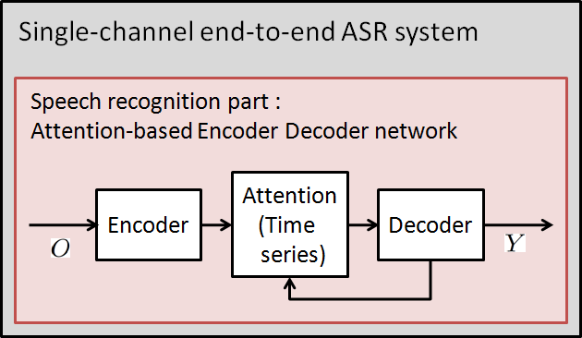
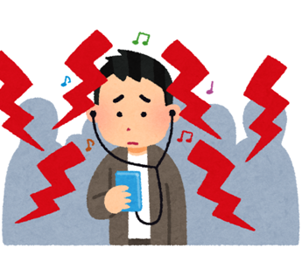
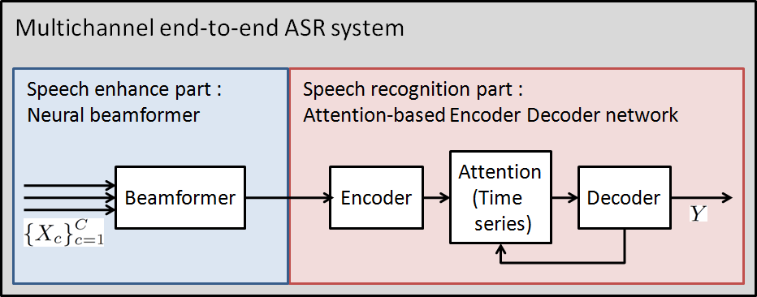
Multichannel end-to-end ASR architecture
[Ochiai et al., 2017, ICML]
Single-channel (Conventional)
Multichannel (Proposed)
03

Slide 41
Overview of entire architecture
Multichannel end-to-end (ME2E) architecture
− models entire process, from speech enhancement (SE) to
− speech recognition (SR), by single neural-network-based architecture
↓
SE : Mask-based neural beamformer [Erdogan et al., 2016]
SR : Attention-based encoder-decoder network [Chorowski et al., 2014]
04

Slide 42
Overview of entire architecture
Multichannel end-to-end (ME2E) architecture
− models entire process, from speech enhancement (SE) to
− speech recognition (SR), by single neural-network-based architecture
↓
SE : Mask-based neural beamformer [Erdogan et al., 2016]
SR : Attention-based encoder-decoder network [Chorowski et al., 2014]
04

Slide 43
Overview of entire architecture
Multichannel end-to-end (ME2E) architecture
− models entire process, from speech enhancement (SE) to
− speech recognition (SR), by single neural-network-based architecture
↓
SE : Mask-based neural beamformer [Erdogan et al., 2016]
SR : Attention-based encoder-decoder network [Chorowski et al., 2014]
04

Slide 44
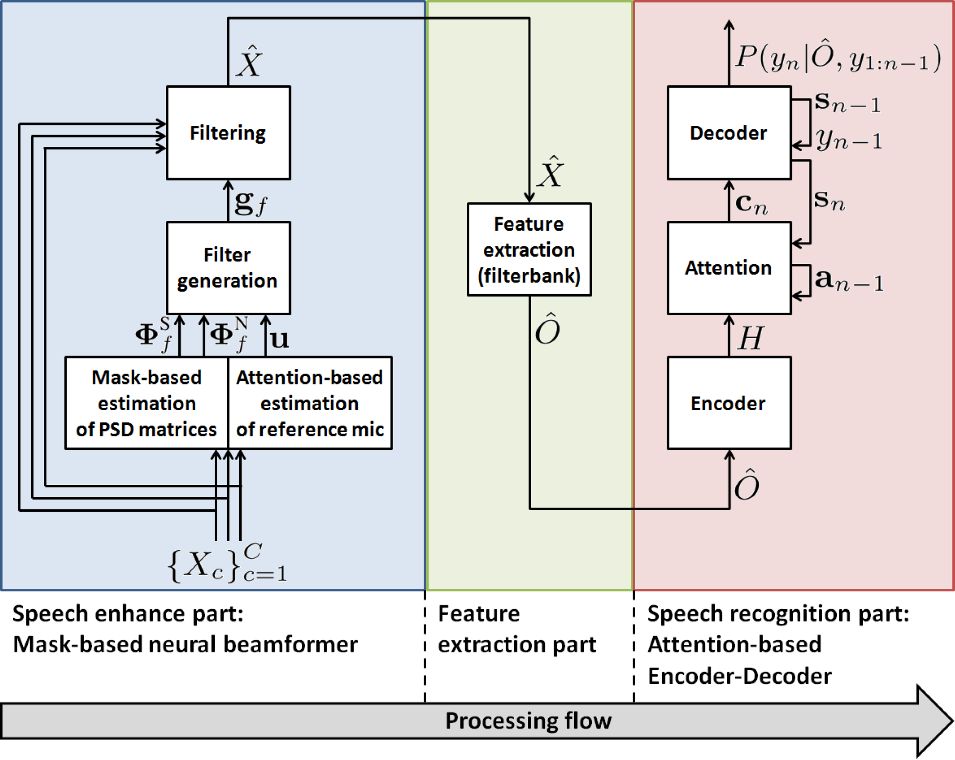
Proposed framework
Overview of entire architecture
Multichannel end-to-end ASR framework
－ models entire process, from speech enhancement (SE) to
－ speech recognition (SR), by single neural-network-based architecture
↓
SE : Mask-based neural beamformer [Erdogan et al., 2016]
SR : Attention-based encoder-decoder network [Chorowski et al., 2014]

Slide 45
Proposed framework
Overview of entire architecture
Multichannel end-to-end ASR framework
－ models entire process, from speech enhancement (SE) to
－ speech recognition (SR), by single neural-network-based architecture
↓
SE : Mask-based neural beamformer [Erdogan et al., 2016]
SR : Attention-based encoder-decoder network [Chorowski et al., 2014]

Slide 46
Proposed framework
Overview of entire architecture
Multichannel end-to-end ASR framework
－ models entire process, from speech enhancement (SE) to
－ speech recognition (SR), by single neural-network-based architecture
↓
SE : Mask-based neural beamformer [Erdogan et al., 2016]
SR : Attention-based encoder-decoder network [Chorowski et al., 2014]

Slide 47
Proposed framework
Overview of entire architecture
Multichannel end-to-end ASR framework
－ models entire process, from speech enhancement (SE) to
－ speech recognition (SR), by single neural-network-based architecture
↓
SE : Mask-based neural beamformer [Erdogan et al., 2016]
SR : Attention-based encoder-decoder network [Chorowski et al., 2014]

Slide 48
Proposed framework
Overview of entire architecture
Multichannel end-to-end ASR framework
－ models entire process, from speech enhancement (SE) to
－ speech recognition (SR), by single neural-network-based architecture
↓
SE : Mask-based neural beamformer [Erdogan et al., 2016]
SR : Attention-based encoder-decoder network [Chorowski et al., 2014]
Single-channel
enhanced signals
Multichannel
noisy signals

Slide 49
Proposed framework
Overview of entire architecture
Multichannel end-to-end ASR framework
－ models entire process, from speech enhancement (SE) to
－ speech recognition (SR), by single neural-network-based architecture
↓
SE : Mask-based neural beamformer [Erdogan et al., 2016]
SR : Attention-based encoder-decoder network [Chorowski et al., 2014]
Single-channel
enhanced signals
Normalized log Mel
filterbank feature
sequence

Slide 50
Proposed framework
Overview of entire architecture
Multichannel end-to-end ASR framework
－ models entire process, from speech enhancement (SE) to
－ speech recognition (SR), by single neural-network-based architecture
↓
SE : Mask-based neural beamformer [Erdogan et al., 2016]
SR : Attention-based encoder-decoder network [Chorowski et al., 2014]
Posterior probabilities
for output label sequence
Normalized log Mel
filterbank feature
sequence

Slide 51
Overview of entire architecture
Multichannel end-to-end (ME2E) architecture
− models entire process, from speech enhancement (SE) to
− speech recognition (SR), by single neural-network-based architecture
↓
SE : Mask-based neural beamformer [Erdogan et al., 2016]
SR : Attention-based encoder-decoder network [Chorowski et al., 2014]
model | Character error rate
Noisy | 29.6
Single-channel E2E + BeamformIt | 24.2
ME2E | 21.5
* Obtained noise robustness through end-to-end training
04

Slide 52
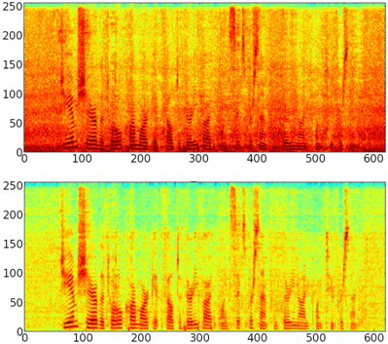
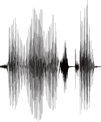
Character error rate (CER)
model | Character error rate
Noisy | 29.6
Single-channel E2E + BeamformIt | 24.2
ME2E | 21.5
* Obtained noise robustness through end-to-end training
Speech samples
Noisy
Extract
enhanced speech
ME2E
04

Slide 53
Discussions
Multichannel end-to-end speech recognition
  Unify speech enhancement/beamforming and speech recognition with a single neural network
  ASR objective function (no need for module-wise optimization)
  Perform enhancement and noise robust ASR at the same time

Slide 54
Outline
End-to-end speech recognition
  Hybrid CTC/attention-based end-to-end speech recognition
  Multi-task CTC/attention learning (ICASSP’17)
  Joint CTC/attention decoding (ACL’17)
Extensions in adverse environments
  Multichannel end-to-end speech recognition (ICML’17, MLSP’17)
  Multi-lingual end-to-end speech recognition (ASRU’17, ICASSP’18)
  Multi-speaker end-to-end speech recognition (ICASSP’18, ACL’18)
Open source project
  ESPnet: End-to-end speech processing toolkit (Interspeech’18)

Slide 55
Speech recognition pipeline
G OW T UW
G OW Z T UW
“I want to go to
Johns Hopkins campus”
Feature extraction
Acoustic modeling
Lexicon
Language modeling
“go to”
“go two”
“go too”
“goes to”
“goes two”
“goes too”
$$p(X|L)$$
$$p(L|W)$$
$$p(W)$$

Slide 56
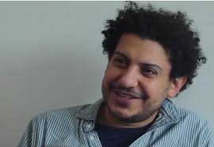
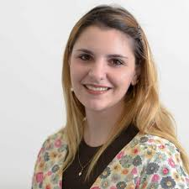
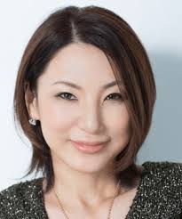
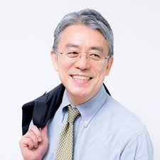
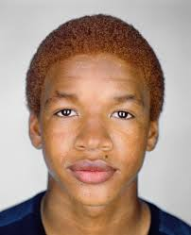
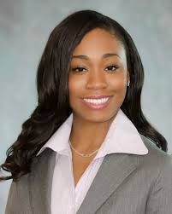
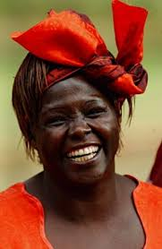

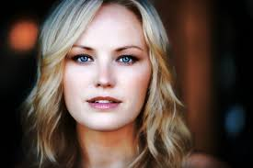
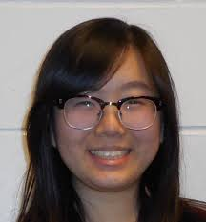
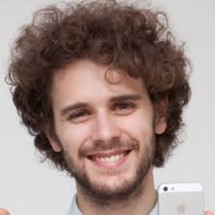
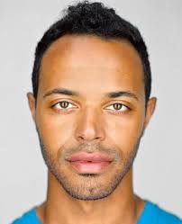
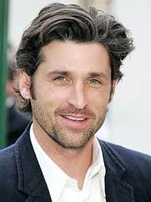



Multilingual speech recognition pipeline
“I want to go to
Johns Hopkins campus”
Language detector
Feature extraction
Acoustic modeling
Lexicon
Language modeling
“ジョンズホプキンスの
キャンパスに行きたいです”
Feature extraction
Acoustic modeling
Lexicon
Language modeling
“Ich möchte gehen
Johns Hopkins Campus”
Feature extraction
Acoustic modeling
Lexicon
Language modeling
$$p(X|L)$$
$$p(L|W)$$
$$p(W)$$

Slide 57
Multilingual speech recognition pipeline
“I want to go to
Johns Hopkins campus”
End-to-end ASR
“ジョンズホプキンスの
キャンパスに行きたいです”
“Ich möchte gehen
Johns Hopkins Campus”

Slide 58
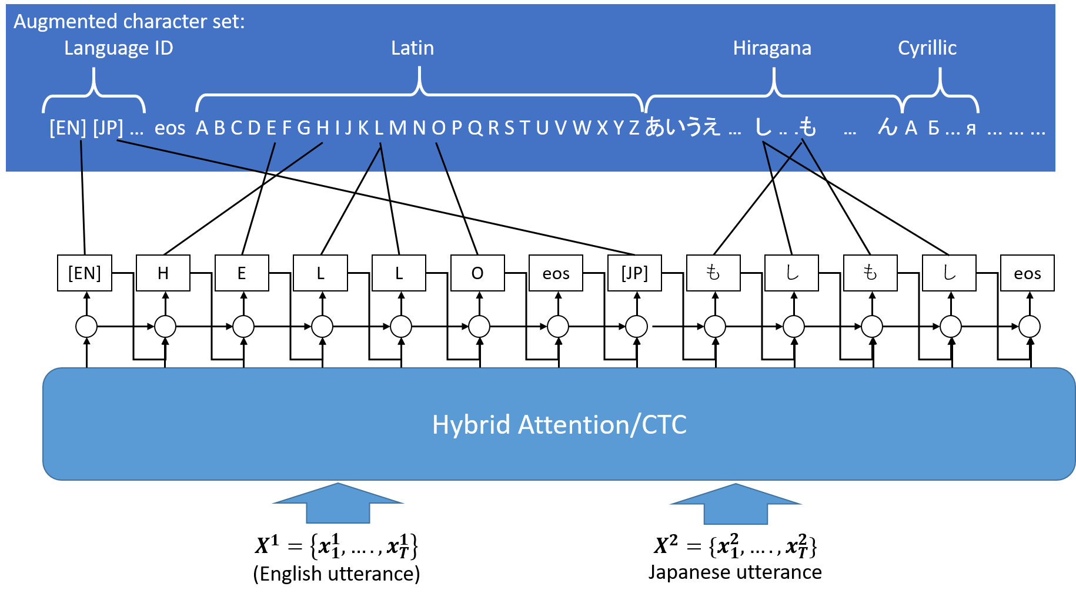
Multi-lingual end-to-end speech recognition [Watanabe+’17, Seki+’18]
Learn a single model with multi-language data (10 languages)
Joint language identification and speech recognition
No pronunciation lexicons

Slide 60
ASR performance for 10 languages
Comparison with language dependent systems
One language per utterance (w/o code switching)
 | 7 languages CER(%) | 10 languages CER(%)
Language-dependent E2E | 22.7 | 27.4
Language-independent E2E (small model) | 20.3 | --
Language-independent E2E (large model) | 16.6 | 21.4

Slide 61
ASR performance for 10 languages
Comparison with language dependent systems
One language per utterance (w/o code switching)
(trained with CSJ, HKUST, WSJ, Voxforge corpora)

Slide 62
ASR performance for Babel 10 languages
Comparison with language dependent systems
Also, language-independent model can be used for a prior model on language-dependent transfer learning

Slide 63
Actually it was one of the easiest studies in my work
Q. How many people were involved in the development?
  A. 1 person
Q. How long did it take to build a system?
A. Totally ~1 or 2 day efforts with bash and python scripting (no change of main e2e ASR source code), then I waited 10 days to finish training
Q. What kind of linguistic knowledge did you require?
A. Unicode (because python2 Unicode treatment is tricky. If I used python3, I would not even have to consider it)

Slide 64
Data generation for multi-lingual code-switching speech
Concatenation of utterances from 10 language corpora
Select number to concat. (1, 2, or 3)
Sample language and utterance:
  P(lang): proportional to corpus duration w/ flooring
  P(utt): uniform distribution
Repeat generation to reach the duration of the original corpora
Duration (hours) of training data.
Corpus |  | Original | Generated
WSJ | English | 81.5 | 87.4
CSJ | Japanese | 216.3 | 149.1
HKUST | Mandarin | 170.1 | 114.9
Voxforge | German | 45.7 | 64.6
 | Spanish | 40.3 | 61.6
 | French | 29.6 | 57.9
 | Italian | 15.8 | 35.7
 | Dutch | 8.4 | 23.6
 | Portuguese | 3.0 | 9.0
 | Russian | 12.0 | 18.5
Total |  | 622.7 | 622.3
Code-switching speech:
utt1
utt2
utt3
EN
JP
DE
...
...

Slide 65
Recognition of speech with code-switching
Character Error Rate (%) on the generated evaluation set.
Trained without code-switching
Flat start on generated data
First train on original without code-switching,
then retrain on generated data with code-switching
Language identification error rate < 10%
language-independent networks

Slide 66
Recognition of speech with code-switching
Character Error Rate (%) on the bilingual-speaker evaluation set.
Trained without code-switching
Flat start on generated data
First train on original without code-switching,
then retrain on generated data with code-switching
Language identification error rate < 15%
language-independent networks

Slide 67
Outline
End-to-end speech recognition
  Hybrid CTC/attention-based end-to-end speech recognition
  Multi-task CTC/attention learning (ICASSP’17)
  Joint CTC/attention decoding (ACL’17)
Extensions in adverse environments
  Multichannel end-to-end speech recognition (ICML’17, MLSP’17)
  Multi-lingual end-to-end speech recognition (ASRU’17, ICASSP’18)
  Multi-speaker end-to-end speech recognition (ICASSP’18, ACL’18)
Open source project
  ESPnet: End-to-end speech processing toolkit (Interspeech’18)

Slide 68
Speech recognition pipeline
G OW T UW
G OW Z T UW
“I want to go to
Johns Hopkins campus”
Feature extraction
Acoustic modeling
Lexicon
Language modeling
“go to”
“go two”
“go too”
“goes to”
“goes two”
“goes too”
$$p(X|L)$$
$$p(L|W)$$
$$p(W)$$

Slide 69




Multi-speaker speech recognition pipeline
“I want to go to
Johns Hopkins
campus”
Speech separation
Feature extraction
Acoustic modeling
Lexicon
Language modeling
“It’s raining
today”
Feature extraction
Acoustic modeling
Lexicon
Language modeling
$$p(X|L)$$
$$p(L|W)$$
$$p(W)$$

Slide 70



Multi-speaker multilingual speech recognition pipeline
“I want to go to
Johns Hopkins
campus”
Speech separation
“今天下雨了”
$$p(X|L)$$
$$p(L|W)$$
$$p(W)$$

Slide 71
Multi-speaker multilingual speech recognition pipeline
Joint separation and recognition with a single end-to-end deep network
End-to-end ASR
“I want to go to
Johns Hopkins
campus”
“今天下雨了”

Slide 72
Purely end-to-end approach [Seki+ ACL’18]
  Not use any explicit separation network
  Incorporate implicit separation via speaker-differentiating (SD) encoders followed by a shared recognition encoder
  Transcript-level permutation-free loss
  No need for target speech in training
  Negative KL loss helps separate
  speaker-differentiating encodings
Resolve permutation and backprop
CTC
Attention decoder
CTC
Attention decoder
L_{KL}
ASR encoder
ASR encoder
SD encoder 1
SD encoder 2
S: number of speakers Y: network output
P: possible permutations R: reference
mixture encoder
input mixture

Slide 73
Purely end-to-end approach [Seki+ ACL’18]
CER (%) of mixed speech for WSJ (w/ word LM)
Comparison with other methods
A bit worse than SS+ASR net but
no need for target speech in training

Slide 74
Multi-lingual ASR
(Supporting 10 languages: CN, EN, JP, DE, ES, FR, IT, NL, RU, PT)
ID | a04m0051_0.352274410405
 | REF: [DE] bisher sind diese personen rundherum versorgt worden [EN] u. s. exports rose in the month but not nearly as much as imports ASR: [DE] bisher sind diese personen rundherum versorgt worden [EN] u. s. exports rose in the month but not nearly as much as imports
ID | csj-eval:s00m0070-0242356-0244956:voxforge-et-fr:mirage59-20120206-njp-fr-sb-570
 | REF: [JP] 日本でもニュースになったと思いますが [FR] le conseil supérieur de la magistrature est présidé par le président de la république ASR: [JP] 日本でもニュースになったと思いますが [FR] le conseil supérieur de la magistrature est présidée par le président de la république
ID | voxforge-et-pt:insinfo-20120622-orb-209:voxforge-et-de:guenter-20140127-usn-de5-069:csj-eval:a01m0110-0243648-0247512
 | REF: [PT] segunda feira [DE] das gilt natürlich auch für bestehende verträge [JP] えー同一人物による異なるメッセージを示しております ASR: [PT] segunda feira [DE] das gilt natürlich auch für bestehende verträge [JP] えー同一人物による異なるメッセージを示しております

Slide 75
Multi-speaker ASR w/ Purely E2E model
ID | 445c040j_446c040f
Out[1] | REF: bids totaling six hundred fifty one million dollars were submitted ASR: bids totaling six hundred fifty one million dollars were submitted
Out[2] | REF: that's more or less what the blue chip economists expect ASR: that's more or less what the blue chip economists expect
ID | 446c040j_441c0412
Out[1] | REF: this is especially true in the work of british novelists and even previously in the work of william boyd ASR: this is especially true in the work of british novelists and even previously in the work of william boyd
Out[2] | REF: as signs of a stronger economy emerge he adds long term rates are likely to drift higher ASR: a signs of a stronger economy emerge he adds long term rates are likely to drive higher
ID | 440c040v_446c040n
Out[1] | REF: shamrock has interests in television and radio stations energy services real estate and venture capital ASR: chemlawn has interests in television and radio stations energy services real estate and venture capital
Out[2] | REF: as with the rest of the regime however their ideology became contaminated by the germ of corruption ASR: as with the rest of the regime however their ideology became contaminated by the jaim of corruption

Slide 76
Multi-lingual Multi-speaker ASR
ID | ralfherzog_1.41860235081
Out[1] | REF: [DE] eine höhere geschwindigkeit ist möglich ASR: [DE] eine höh*re geschwindigkeit ist möglich
Out[2] | REF: [JP] まずなぜこの内容を選んだかと言うと ASR: [JP] まずなぜこの内容を選んだかと言うと
ID | a02m0012_s00f0066
Out[1] | REF: [EN] grains and soybeans most corn and wheat futures prices were stronger [CN] 也是的 ASR: [EN] grains and soybeans most corn and wheat futures prices were strongk [CN] 也是的
Out[2] | REF: [JP] えーここで注目すべき点は例十十一の二重下線部に示すように [JP] アニメですとか ASR: [JP] えーここで注目すべきい点は零十十一の二十下線部に示すように [JP] アニメですとか
ID | a04m0051_0.352274410405
Out[1] | REF: [IT] economizzando le provvIste vi era da vivere per lo meno quattro gIorni [EN] the warming trend may have melted the snow cover on some crops ASR: [IT] e cono mizzando le provveste vi*era da vivere per lo medo quattro gorni [EN] the warning trend may have mealtit the sno* cover on some crops
Out[2] | REF: [JP] でそれぞれの発話数え情報伝達の発話数一分当たりの発話数はえ多くなってますがえ問題解決だと少し少なくなるでディベートだとおー ASR: [JP] でそれですのでの発話スえ情報伝達の発話数一分当たり発話数はえ多くなってますがえ問題解決だと少してなくてでディベートだとおー

Slide 77
Discussions
Multilingual end-to-end speech recognition
  Fully make use of the advantage of end-to-end ASR, that is no need for pronunciation dictionary
  Language identification and speech recognition at the same time
Multi-speaker end-to-end speech recognition
  Speech separation and recognition at the same time (tackling cocktail party problem)
A lot of ideas and applications would be realized by using end-to-end architectures
  ➡︎ Accelerate these activities by providing open source toolkit

Slide 78
Outline
End-to-end speech recognition
  Hybrid CTC/attention-based end-to-end speech recognition
  Multi-task CTC/attention learning (ICASSP’17)
  Joint CTC/attention decoding (ACL’17)
Extensions in adverse environments
  Multichannel end-to-end speech recognition (ICML’17, MLSP’17)
  Multi-lingual end-to-end speech recognition (ASRU’17, ICASSP’18)
  Multi-speaker end-to-end speech recognition (ICASSP’18, ACL’18)
Open source project
  ESPnet: End-to-end speech processing toolkit (Interspeech’18)

Slide 79


ESPnet: End-to-end speech processing toolkit
Shinji Watanabe
Center for Language and Speech Processing
Johns Hopkins University
Joint work with Takaaki Hori , Shigeki Karita, Tomoki Hayashi, Jiro Nishitoba, Yuya Unno, Nelson Enrique Yalta Soplin, Jahn Heymann, Matthew Wiesner, Nanxin Chen, Adithya Renduchintala, Tsubasa Ochiai,
and more and more

Slide 80
ESPnet
Open source (Apache2.0) end-to-end speech processing toolkit
  Developed for the 2018 JSALT workshop “Multilingual End-to-end ASR for Incomplete Data”
  Actively developed by researchers all over the world (JHU, MERL, Nagoya Univ., NTT, etc.)
Major concept
  Accelerates end-to-end ASR studies for speech researchers (easily perform end-to-end ASR)
Chainer or PyTorch based dynamic neural network toolkit as an engine
  Easily develop novel neural network architecture
Follows the Kaldi style
  Data processing, feature extraction/format
  Recipes to provide a complete setup for speech processing experiments

Slide 81
Functionalities
Kaldi style data preprocessing
  fairly comparable to the performance obtained by Kaldi hybrid DNN systems
  easily porting the Kaldi recipe to the ESPnet recipe
Attention-based encoder-decoder
  Subsampled BLSTM and/or VGG-like encoder and location-based attention (+10 attentions)
  beam search decoding
CTC
  WarpCTC, beam search (label-synchronous) decoding
Hybrid CTC/attention
  Multitask learning
  Joint decoding with label-synchronous hybrid CTC/attention decoding (solve monotonic alignment issues)
Use of language models
  Combination of RNNLM trained with external text data (shallow fusion)

Slide 82


Not only for ASR!
ESPnet supports text to speech (TTS)!
This is a very unique open source tool to support both ASR and TTS with same manners
Encode
Decode
Encode
Decode

Slide 83

Not only for ASR!
ESPnet supports Speech translation
IWSLT 2018: English speech to German text
English speech
German text (ESPnet result)
Die nächste Folie , die ich Ihnen zeigen werde , " Was wir in den letzten 25 Jahren an der Zeit
Counterattack from speech researchers
The next slide I show you will be a rapid fast-forward of what's happened over the last 25 years.

Slide 84
Supported recipes (20 recipes)
ami
an4
babel
chime4
chime5
csj
fisher_swbd
hkust
hub4_Spanish
iwslt18st (speech translation)
jsalt18e2e
li10
librispeech (ASR)
librispeech (multi-speaker TTS)
ljspeech (single-speaker TTS)
reverb
swbd
tedlium
voxforge
wsj

Slide 85
Supported languages (25 languages)
Major English tasks (WSJ, Fisher+Switchboard, Librispeech)
Japanese (Corpus of Spontaneous Japanese)
Mandarin (HKUST CTS)
Babel 15 languages
Cantonese , Assamese, Bengali, Pashto, Turkish, Georgian, Tagalog , Vietnamese , Haitian, Swahili, Lao, Tamil, Zulu, Kurmanji Kurdish, Tok Pisin
VoxForge 7 languages
German, Spanish, French, Italian, Portuguese, Russian, Dutch

Slide 86
Experiments (< 80 hours)
Word Error Rate [%] in Wall Street Journal (WSJ) task
Models | dev93 | eval92
ESPnet | 7.0 | 4.7
Attention model + word 3-gram LM [Bahdanau 2016] | - | 9.3
CTC + word 3-gram LM [Graves 2014] | - | 8.2
CTC + word 3-gram LM [Miao 2015] | - | 7.3
Attention model + word 3-gram LM [Chorowski 2016] | 9.7 | 6.7
Hybrid CTC/attention, multi-level LM | - | 5.6
Wav2Letter with gated convnet | - | 5.6
HMM/DNN + sMBR + word 3-gram LM | 6.4 | 3.6
HMM/DNN + sMBR + word RNN-LM | 5.6 | 2.6
Our best end-to-end
End-to-end best
DNN/HMM best

Slide 87
Experiments (> 100 hours)
Character Error Rate [%] in HKUST Mandarin telephony task
Models | dev
ESPnet | 27.4
CTC with language model [Miao (2016)] | 34.8
HMM/DNN + sMBR | 35.9
HMM/LSTM (speed perturb.) | 33.5
HMM/DNN + Lattice-free MMI | 28.2
Our best end-to-end
End-to-end best

Slide 88
Experiments (> 100 hours)
Character Error Rate [%] in HKUST Mandarin telephony task
Models | dev
ESPnet | 27.4
CTC with language model [Miao (2016)] | 34.8
HMM/DNN + sMBR | 35.9
HMM/LSTM (speed perturb.) | 33.5
HMM/DNN + Lattice-free MMI | 28.2
HMM/DNN + Lattice-free MMI (latest) | 23.7
Our best end-to-end
End-to-end best
DNN/HMM best
  The gap comes from latest sequence-discriminative training progress
  → Full search to consider all possible decoding hypotheses

Slide 89
Experiments (~ 1,000 hours)
Word Error Rate [%] in Librispeech task
Models | test_clean
ESPnet (first version) | 7.1
ESPnet (latest) | 4.0
Mozilla Deep Speech | 6.6
Deep Speech2 | 5.3
Facebook Gated ConvNet | 4.8
RWTH pre-training seq2seq | 3.8
HMM/DNN + sMBR (nnet3 tdnn, Kaldi) | 4.6
HMM/DNN + Lattice-free MMI (Kaldi) | 3.9
HMM/DNN + Lattice-free MMI by Capio | 3.2
Our best end-to-end
  Several tuning (network topologies) achieves the significant improvement
  Thanks to RWTH and Google researchers
  We still have some potentials to improve?
End-to-end best
DNN/HMM best

Slide 90
Summary of my talk
End-to-end speech processing has a lot of potentials
  Multichannel, multilingual, multispeaker ASR
Reasonable and reproducible performance
  ESPnet provides whole experimental procedure
  Comparable ASR performance to the HMM/DNN (when >100h)
Future work
  We still need to fill out the gap between DNN/HMM (lattice-free MMI chain) and E2E
  More applications! (Multimodal, TTS+ASR, ASR/TTS + MT)
GMM/HMM | < | DNN/HMM+ sMBR | ~ | ESPnet (end-to-end) | < | DNN/HMM + LF-MMI
SOTA ~2011 |  | SOTA ~2016 |  |  |  | Current SOTA

Slide 91
Take home message

Slide 92
Sequence-to-Sequence is a perfect tool!!

Slide 93

Sequence-to-Sequence is a perfect tool!!

Slide 94
Multichannel end-to-end ASR architecture

Slide 95
Multichannel end-to-end ASR architecture
BLSTM, CNN,
or whatever

Slide 96
Multichannel end-to-end ASR architecture

Slide 97
Multichannel end-to-end ASR architecture
Carefully design a neural network to meet signal processing knowledge (i.e., bemforming)
Still one neural network (everything differentiable)
We can provide the meaning of the each component (not black box)
Good combination of data-driven and model-based techniques

Slide 98
Multichannel end-to-end ASR architecture
Carefully design a neural network to meet signal processing knowledge (i.e., bemforming)
Still one neural network (everything differentiable)
We can provide the meaning of the each component (not black box)
Good combination of data-driven and model-based techniques

Slide 99
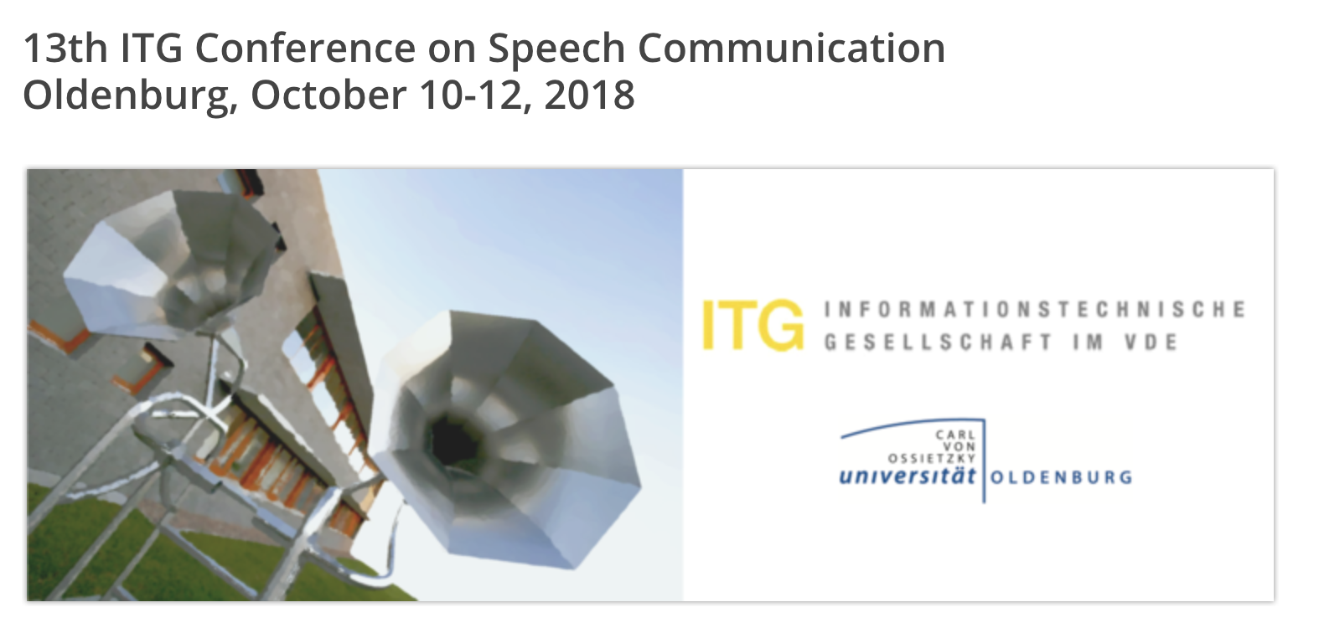
Carefully design a neural network to meet signal processing knowledge (i.e., bemforming)
Still one neural network (everything differentiable)
We can provide the meaning of the each component (not black box)
Good combination of data-driven and model-based techniques

Slide 100
Thanks!

